Slide 1

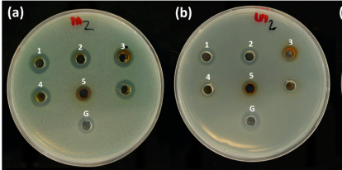
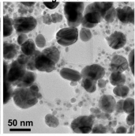
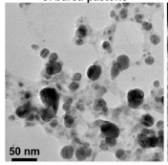
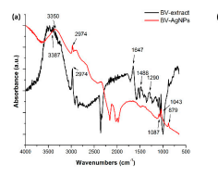
Title
Names of authors (fist and last name)
authors affiliation
Logoof your university and/or Research Laboratory
Reerence-code
1-Abstract
3- Analysis & results
Arial
6- Conclusion.
2- Mthodology
4- Illustration (Image, graphique, scheme, photo…)
A picture is worth a thousand words. The illustration must support the point. It must inform the reader!
7- References
Légende de l’illustration
5- Illustration
8-Acknowledgments
and contact
@ courriel and internet site
The legend of l’illustration

